Slide 1

Department of Developmental Services
Northeast Region
Family Forum
Self-Determination and
DDS Service Models
2016

Slide 2
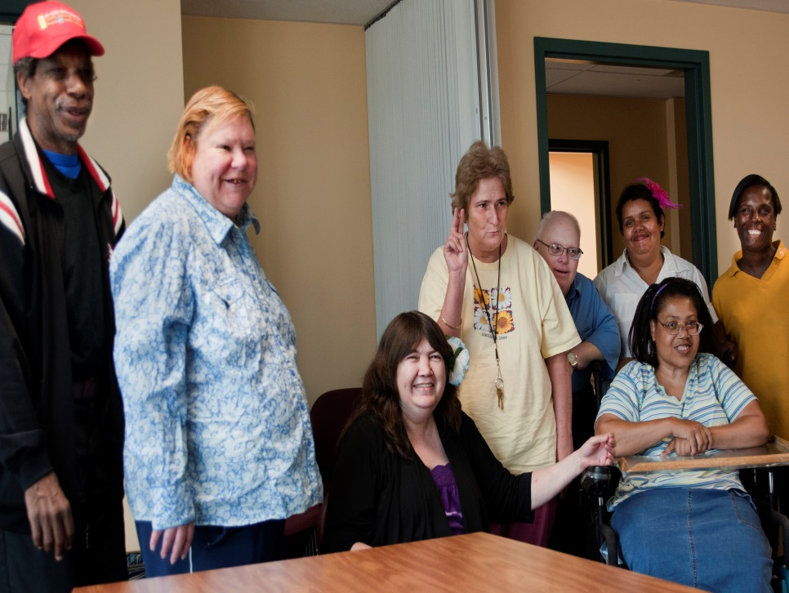
INTRODUCTION
Self-Direction is a way of providing supports to individuals that promotes personal choice and control over decision making. This includes allowing individuals and/or families to decide who provides those supports
and how and when they are
delivered.
Self-Direction is based on the
idea that individuals and/or
families are in the best
position to know what they
want and need.

Slide 3

Why Consider Self Direction?
Self-Direction allows individuals to
be more engaged in directing their
own lives and to use their own voices.
Self-Direction requires people who
provide supports to listen and
respect the choices and decisions
individuals make. By self-directing
their supports individuals now have
greater control and responsibility
and enjoy a greater quality of life.

Slide 4
Models of Service Delivery
In DDS there are 3 ways services can be delivered:
1)The Traditional model
2) Agency With Choice (AWC)
3) Participant Directed Program (PDP)

Slide 5
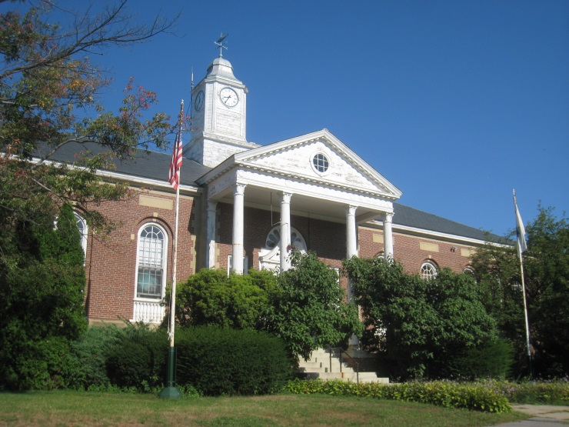


What Is The Traditional Model of Service Delivery?
The Traditional Model of community supports began with the closing of large state institutions and has been available to individuals/families for almost a half a century. It is the most commonly used model in Massachusetts.
In this model, the provider agency (pre-qualified and licensed agencies) contracts directly with DDS to deliver a specific range of supports (e.g. shared living, group homes, employment and day programs) to the individual. The agency has full authority and responsibility for all hiring, training, supervising and paying employees and for providing all other needed goods and services to the individuals in their programs .

Slide 6
What Is The Traditional Model Of Service Delivery? - Continued
The individuals, their families and service teams develop Individual Service Plans (ISP) and provide input on some other day to day decisions (e.g. activities in and out of home, meal choices and the time of meals, bedtime, furnishings etc.).
The provider agency has the responsibility for managing all aspects of the budget so that the services in the contract and ISP are provided according to applicable federal and state laws, DDS and other state regulations, as well as other DDS requirements.

Slide 7
What Is The Traditional Model Of Service Delivery? - Continued
In the traditional model, the individual or family can choose the provider agency and the particular location (from those that are available) where they receive their services, however they can not choose the staff; while they may have input, they can not choose all activities, schedules and changes; and they do not control the funds that pay for the services they receive.
The provider agency has full authority and responsibility over all aspect of the services (as directed in the ISP) the person receives and the other goods (groceries, furniture, leisure activity supplies….) and supports (banking, paying bills, assuring regulations are followed…..) that accompany the ISP services.

Slide 8
Examples Of Traditional Models
Group living in provider or state operated homes
Day programs such as group employment support programs, Adult Day Health, group volunteer activity programs
Contracted transportation to and from day activities
Individual supports and shared living through a traditional contract with the provider agency and DDS

Slide 9
Other DDS Models Offer Self-Determination
The other 2 models or ways people can choose to receive their services are based in the concept of Self-Determination. First it is helpful to understand the terms Self-Determination and Self-Direction.
Self-Determination is the concept of having control in one’s life to make choices based on preferences, beliefs and abilities to influence one’s future.
Self-Direction is a process through which individuals determine the course of their lives by designing and directing their own services. In DDS the two service delivery options that offer different levels of self-direction are the Agency With Choice and Participant Directed Program models.

Slide 10

Principles of Self-Determination*
  Freedom to decide how one wants to live his or her life
  Authority over a targeted amount of dollars
  Support to organize resources in ways that are life enhancing and meaningful to the individual
  Responsibility for wise use of public dollars and the recognition of the contributions individuals across disability and aging can make to their communities
  Confirmation of the important roles individuals must play in the newly designed system
*From the website www:centerforself-determination.com

Slide 11

How Can Individuals Achieve Self-Determination?
Individuals determine the course of their lives by designing and directing their own services. This process is called self-direction. The two DDS models of service delivery to direct one’s services:
Agency With Choice (AWC)
Participant Directed Program (PDP)

Slide 12

What Is Agency With Choice?
  The Agency With Choice (AWC) allows individuals and families to purchase services and to choose and supervise their staff and other supports without having to be responsible for all administrative duties associated with being an employer and purchaser of goods and services. The provider agency is responsible for hiring staff and purchasing goods and services.

Slide 13
What Is Agency With Choice? - Continued
In Agency With Choice the individual negotiates with the agency (with assistance) in the design of his/her services and
chooses and directs their staff without the administrative
and paperwork responsibilities associated with being an
employer and
managing
a budget.

Slide 14

What Is Agency With Choice? - Continued
When hiring staff to provide services, the individual/family may choose their own employee candidates provided those candidates meet agency requirements, or they may choose from available staff people who are employed by the agency.
The individual/family selects the employees he/she recommends or employees made
available through the agency, sets work hours and terms of employment, provides daily
supervision and management of employees, and determines when that staff
person is no longer needed.
The provider agency and individual/family share
in training and evaluating employees.

Slide 15

What Is Agency With Choice? - Continued
The individual (or family) also makes other decisions about how to use their DDS
funded allocation based on the vision and needs in the ISP.
The provider agency is responsible for managing all aspects of the budget so that the services in the contract and ISP are provided.

Slide 16

Agency will work with Individual to identify the vision and needs.
Assist in identifying what expenses are allowed under guidelines.
Payroll requirements will be managed by Agency with Choice Provider.
Agency takes care of arranging for the purchase of other goods and services authorized in the budget and assures that such bills are paid.

Slide 17

Who Can Choose the AWC Model?
To participate in AWC supports, a person must:
1) be eligible for DDS supports
2) have an assessed need for the services to be provided
3) if applicable, be prioritized for DDS services
be willing and able to work cooperatively
with the provider agency
be responsible for the day-to-day
management and supervision of
the employees

Slide 18

Example of Agency with Choice
Sean is a young man who turned 22 in September. He has a diagnosis of intellectual disability and autism. Sean has great difficulty being in a group setting because of his reaction to loud noise and his adverse reaction to
crowds. He had a very individualized
educational day program provided by his
school system, primarily consisting of 1:1
activities in an isolated setting.

Slide 19

Example Of Agency With Choice - Continued
Sean’s parent’s vision for him included developing friendships and learning skills necessary to become employed.
They decided to pursue the Agency with Choice model for services because they wanted to self-direct services but with the assistance from the agency to be
responsible for the employee
related functions.

Slide 20

Example Of Agency With Choice - Continued
With the help of his AWC provider, they created a community based program where Sean is involved in community volunteer activities and his interactions with others can be limited. They also created an internship with Papa Gino’s. The company allows Sean to come to their restaurant before it opens to learn skills related to food preparation and facility cleaning. Sean spends two hours, three days a week at Papa Gino’s with his support staff. He leaves just before the restaurant opens.

Slide 21

Example Of Agency With Choice - Continued
The goal is to introduce Sean gradually to patrons when few customers are there, and then increase his time with others at the restaurant as tolerated. The family has found that the AWC model allows them to have as much control over Sean’s supports as they feel they can handle at this time. The relationship between Sean and the AWC agency has been beneficial to both he and his parents. Sean will have opportunities to grow over the coming years though the unique supports created for him in this model.

Slide 22

What Is The Participant Directed Program Model?
The Participant Directed Program (PDP) option offers the individual/family the most flexibility to arrange and customize supports based on
the individual’s needs and
preferences. The individual can
hire their own support staff, design
their schedule, and make other
decisions about how to use their
DDS funded allocation.

Slide 23

Participant Directed Program - Continued
Participant Directed Program offers the individual the most control, authority and responsibility over his/her services and budget. It includes support for the individual to design, plan, monitor and evaluate services and a system that manages paperwork, accounting and compliance.
The person and/or family self-directing makes their own decisions, determines how their DDS funding is spent for services, supports and goods (within DDS guidelines), and takes responsibility for the decision he or she makes.
Control

Slide 24


Participant Directed Program - Continued
A fiscal intermediary (FI) serves as the agent for individuals and families and is responsible for all payments. The FI pays support staff, and other goods and services in accordance with the participant’s budget. The FI provides financial monitoring and reporting and ensures compliance with all applicable federal and state laws, DDS and other state agency regulations, and with other DDS requirements.

Slide 25
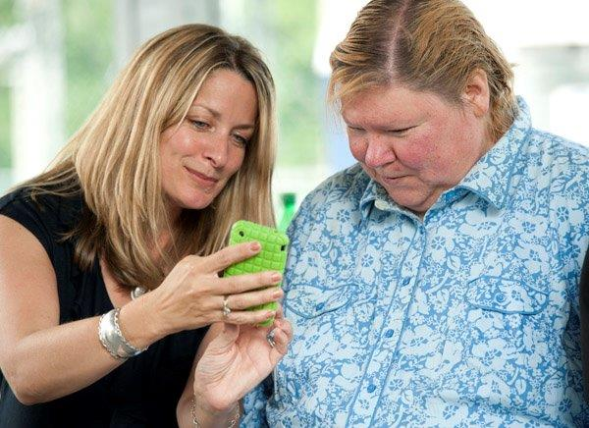
Participant Directed Program - Continued
A Support Broker, typically a DDS Service Coordinator, helps the person define his or her needs and visions through a person centered planning process that leads to an Individual Service Plan. The Support Broker helps the individual create and manage a budget within the allocated resources, and develop a network of services/supports.
The Support Broker also acts on behalf
of the individual to arrange for
needed services, to provide information
on resources and to support the
individual in evaluating the
effectiveness of supports.

Slide 26

Control of a specific amount of funds he or she is authorized to use.
Person directs and supervises the delivery of services.
Responsibility and freedom to purchase supports, services and goods from a variety of sources (within DDS Guidelines).
Person is responsible (with some assistance) for completing necessary paperwork.
Fiscal management services are provided by a Fiscal Intermediary, currently Public Partnership Limited. The Fiscal Intermediary also assures compliance with DDS guidelines and state and federal laws.

Slide 27
Who Can Enroll in the Participant Directed Program?
To enroll in the Participant Directed Program (PDP), a person must:
1) be eligible for DDS supports
2) have an assessed need for the services to be provided
3) if applicable, be prioritized for DDS services
4) receive a DDS allocation
5) be willing and able to work cooperatively with a Support Broker
6) be responsible, working closely with a Support Broker as needed, to manage their
services and budget
Individuals meeting the above criteria in adult services, children in the Department of Elementary and Secondary Education (DESE) program, and adults in the Autism Services Division may choose the Participant Directed Program as their method of service delivery. All participants in the Children's Autism Waiver program direct their services.

Slide 28
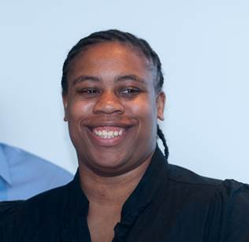
Example of Participant Directed Program
Lisa says, “ I feel more like an adult!”
Lisa is a 34 year old woman with a million
dollar smile that lights up a room. She was
adopted by her foster mother who later became
her legal guardian. When her mother bought a
building with a separate apartment, Lisa had an
opportunity to move there and work on becoming
more independent. Lisa jumped at the chance.
She decided to self-direct her own services through the Participant Directed Program. She purchased Individualized Home supports by hiring a worker to visit each week and help her stay on track with her goals.

Slide 29

Example Of PDP - Continued
The first worker didn’t provide her with the supports she needed so she interviewed and hired a different person. With the support of her current worker, she has grown by leaps and bounds. For example, after taking a cooking class Lisa decided she wanted to cook more independently at home. Previously she never had any real interest in cooking and relied on others to prepare meals for her. Lisa set her mind to it and now cooks meals at home on a regular basis. A few years ago she joined a Zumba class. That experience brought out the natural born leader in Lisa and she is very helpful with others that need more assistance. She is always willing to lend a hand to teach someone something.

Slide 30

Example of PDP Continued
Being able to make her own choices through self-directed services has strengthened Lisa’s confidence and willingness to try new things. Lisa feels her biggest accomplishment is her comfort in negotiating with her mother. Lisa used to doubt herself, now she can talk with
her mother about decisions
she is making.

Slide 31
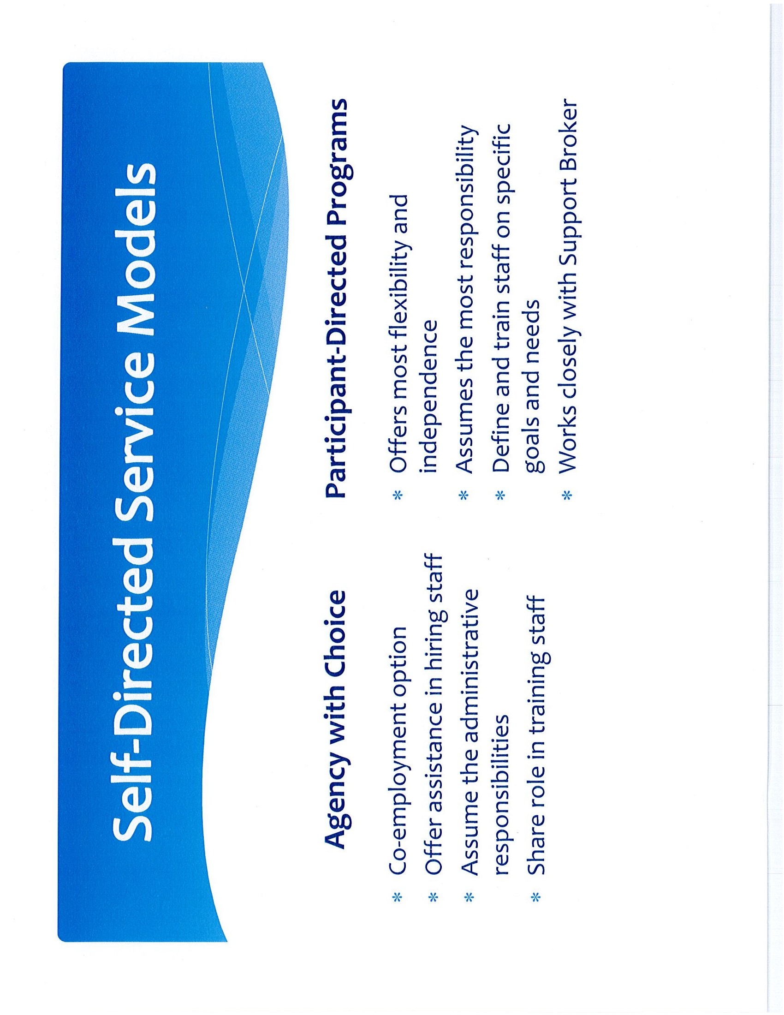

Slide 32
The Real Lives Law
  A law (Chapter 255 of the Acts of 2014) that supports and strengthens the values and commitments related to self-determination was signed on August 6, 2014. It is commonly referred to as the Real Lives Law.
  This law has many provisions and requirements. One provision is the establishment of a 22 person Advisory Board to advise DDS on matters relative to self-determination. The DDS Self-Determination Advisory Board (SDAB) began meetings in January of 2015.
See next slide for where to access more information on the law and the work of the SDAB.

Slide 33
For More Information On Self-Determination in DDS
1) For General Information:
Go to mass.gov/ehhs/dds. Look on the far left column and click on Self-Determination.
On this site you will find documents related to DDS work on self-determination from the past several years as well as links to the Real Lives Law, the SDAB membership list, the Work Plan related to the law, links to provider agency information and much more. You can also provide feedback to DDS via this website and through the feedback form for this review.

Slide 34
For More Information On Self-Determination in DDS
2) To Explore Self Direction for you or your family member contact your Area Office Service Coordinator. Below is a list of the Northeast Region Area Offices with addresses and phone numbers.

